Slide 1
Kernel Methods
Hardik Siloiya
SoS 2021 (IIT Bombay) – Data Science

Slide 2
Support Vector Machines
Support Vector machines are supervised learning models with associated learning algorithms that analyze data for classification and regression analysis. Developed at AT&T Bell Laboratories by Vladimir Vapnik with colleagues.
We are given n points of the form (x₁,y₁), …, (x_{n}, y_{n}) , where the y_{i} are either 1 or -1, indicating the class to which the vector x_{i} belongs to. We want to find the maximum-margin hyper plane that divides the group of points x_{i} for which y_{i} =1 from the group of points for which y_{i} = -1, which is defined so that the distance between the hyper plane and the nearest point x_{i} from either group is maximized.

Slide 3
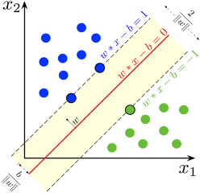
Example for an SVM
Maximum-margin hyper plane and margins for an SVM trained with samples from two classes. Samples on the margin are called the support vectors.

Slide 4
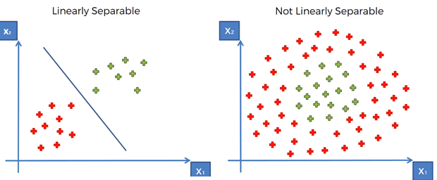
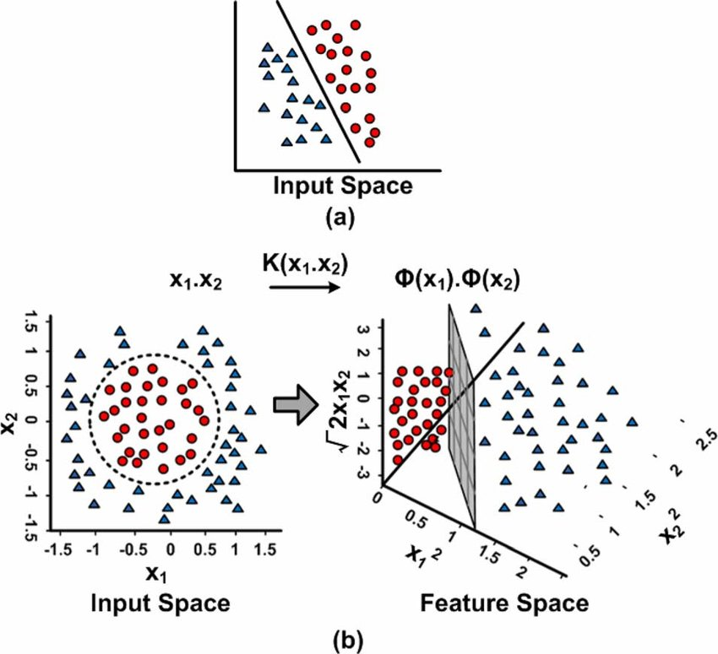
Non linearly separable data and the need for Kernels

Slide 5
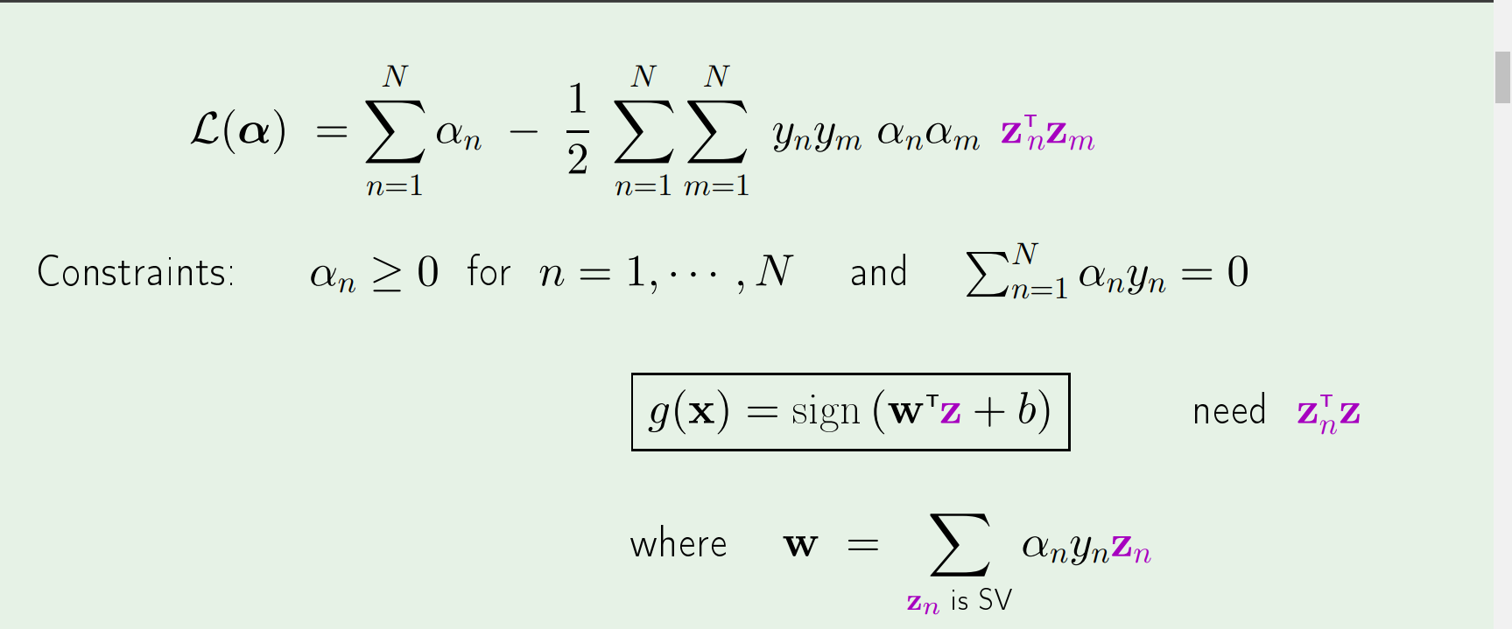
What we need from the Z space

Slide 6
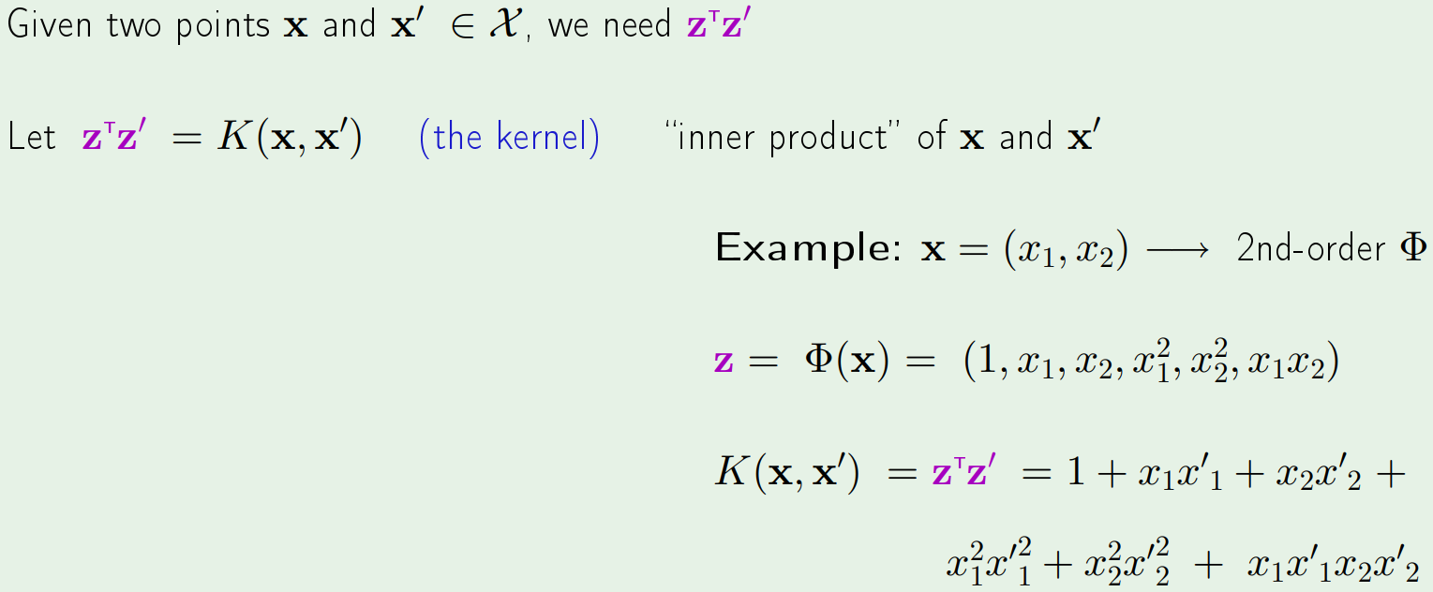
Generalized inner product

Slide 7
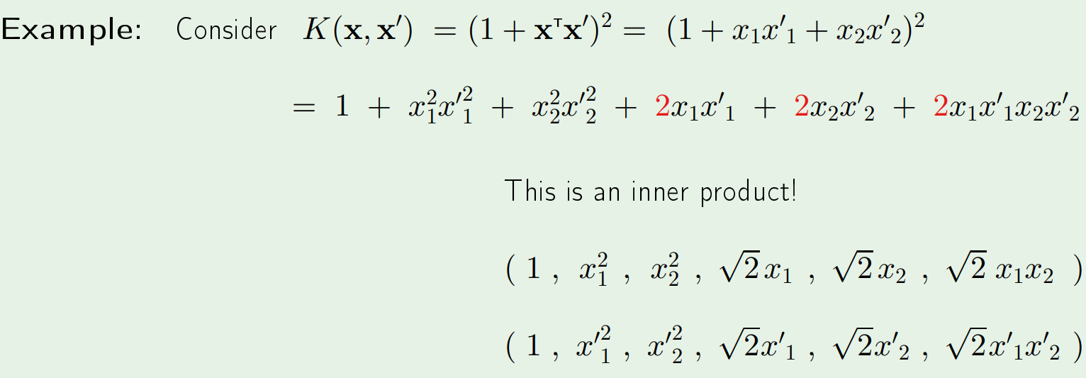
Can we compute K(x, x’) without transforming x and x’?

Slide 8
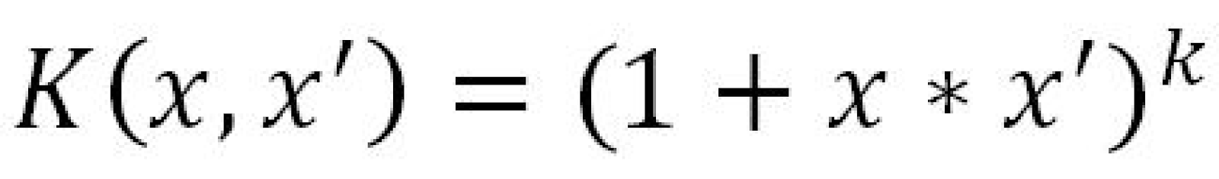
The polynomial Kernel

Slide 9
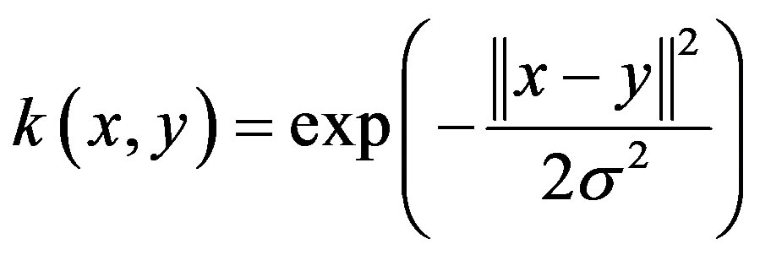
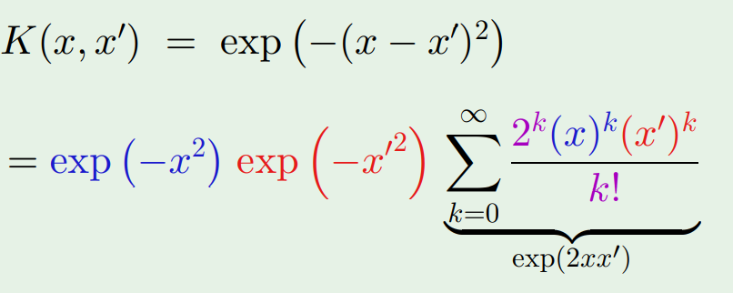
Only need Z to exist

Slide 10
Conclusions
Can create any Kernel as long as Z space exists, for that the Kernel Matrix should be symmetric and positive semi-definite.
Can help in classification problems involving non-linearly separable data but should be careful so as to not increase the generalization error due to the over fitting of the support vector classifier on the data. This can be measured by counting the number of support vectors the final separation line has, with higher number of support vectors increasing generalization error.

Slide 11
References
https://work.caltech.edu/library/151.pdf
Support-vector machine - Wikipedia

